Slide 1

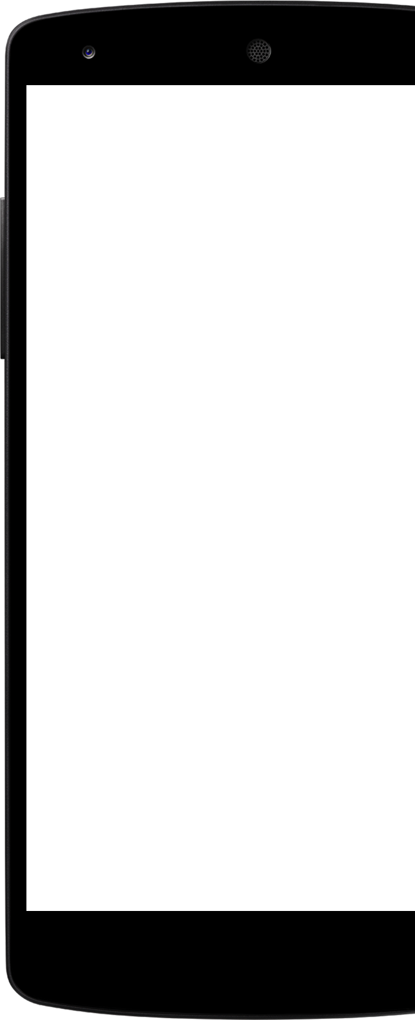
COUPON ADDA
Team:
1)Sujit Nisad
2) Daith Kumar
3) Srikanth Anegall

Slide 2
Outline
Problem Statement
Objective
Project Overview
Onboarding-Architecture
Project Flow
Technology and Tools Used
Conclusion

Slide 3
Problem Statement
We regularly receive numerous promo codes from numerous merchant applications, including Zomato, Lensekart, and others, as a result of various actions we do. The issue is that not all customers Utilize discount codes correctly, and some customers wait for coupons from particular Retailers. We developed this project as a web application to give different promo codes for end users by collecting from unused users in order to solve such a problem.

Slide 4
Objective
Providing an end-user web application for the use of unwanted coupon codes from various merchant apps with various users.

Slide 5
Project Overview

Slide 6
Project Overview
Project Overview
Search
Coupon
API
Login
Add coupon
Home
Wallent
Sql
Server
Register
Purchase

Slide 7
Onboarding Architecture

Slide 8
Architecture
Login/Register
Validation
API
SQL Server
POST Delete
PUT
GET/DELETE
Front End
MVC
GET
Search Coupon
API
GET
GET

Slide 9
Project Flow

Slide 10
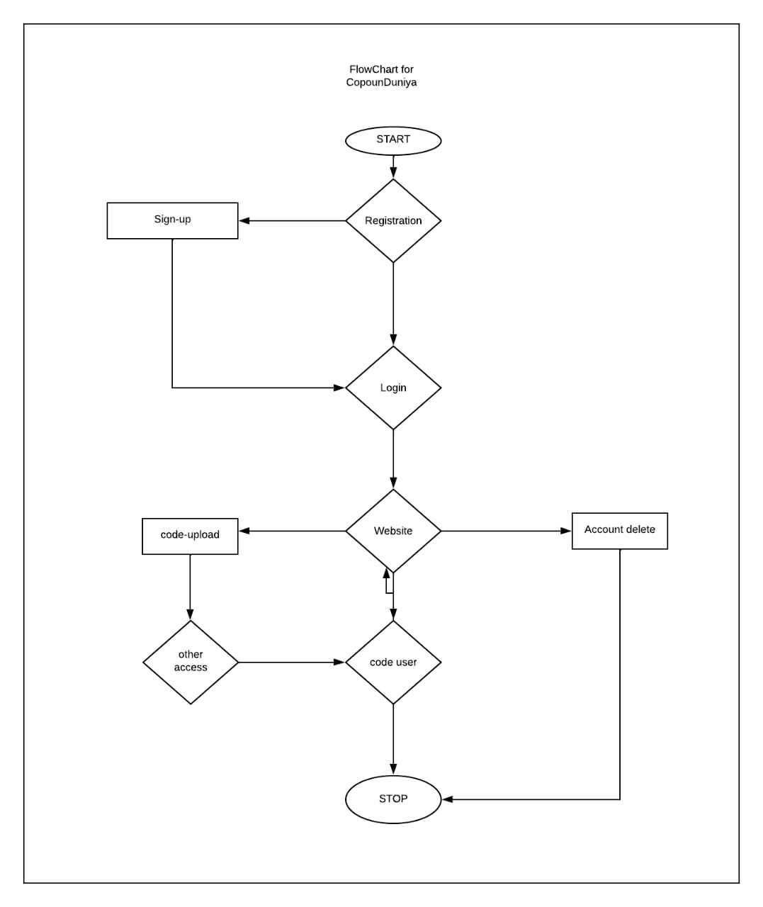
Project Flow

Slide 11





Technologies and Tools Used

Slide 12
Conclusion
The Coupon web app helps the user to use coupons at online. It also helps user to
earn money by sharing coupon.

Slide 13
Thank You

Slide 14


